Slide 1
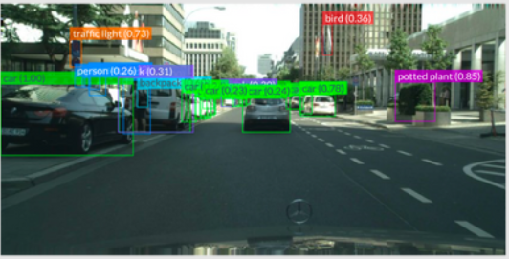
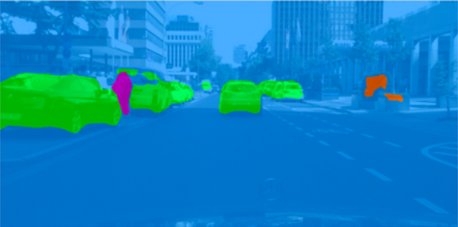
L4 Object Detection and Segmentation
Zonghua Gu, Umeå University
Nov. 2023
Notes:
https://www.thinkautonomous.ai/blog/image-segmentation-use-cases/

Slide 2
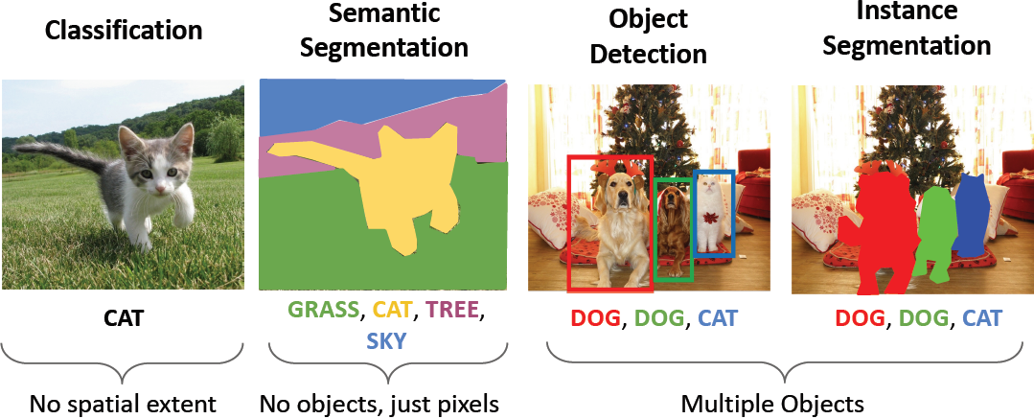
Computer Vision Tasks

Slide 3
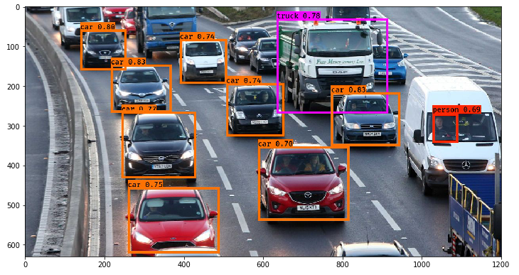
Outline
Object detection
Segmentation

Slide 4
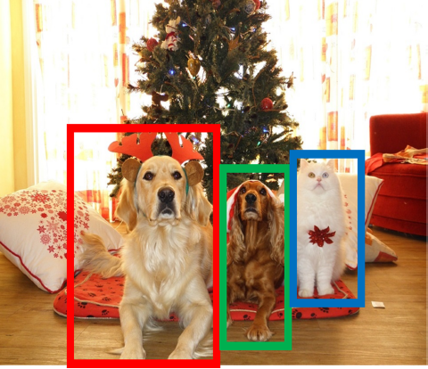
Object Detection: Task Definition
Input: Single Image
Output: a set of detected objects
For each object predict:
WHAT: Class label (e.g., cat vs. dog)
WHERE: Bbox (4 numbers: x, y, width, height)
Challenges:
Multiple outputs: variable numbers of objects per image
Multiple types of output: predict ”what” (class label) as well as “where” (Bbox)
Large images: Classification works at 224x224 or lower; need higher resolution for detection, often ~800x600

Slide 5
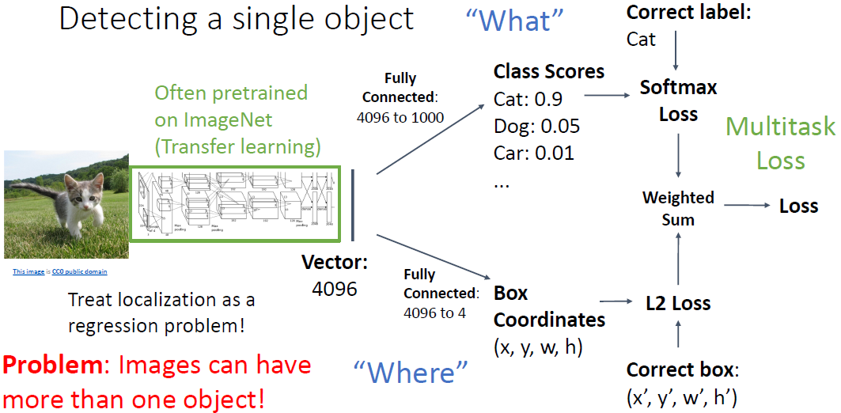
Single-Object Detection

Slide 6
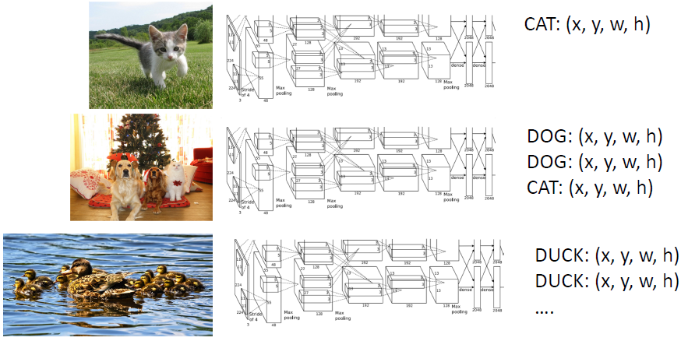
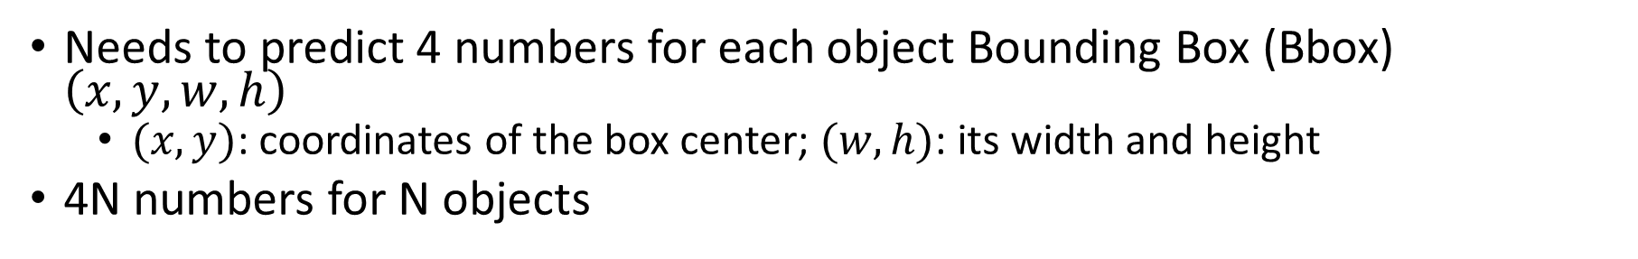
Multi-Object Detection
Needs to predict 4 numbers for each object Bounding Box (Bbox) $\left(x, y, w, h\right)$
$(x, y)$: coordinates of the box center; $(w, h)$: its width and height
4N numbers for N objects

Slide 7
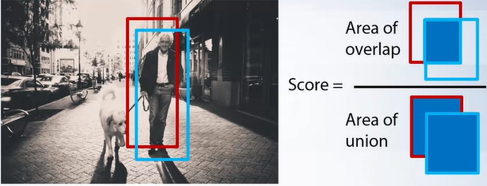
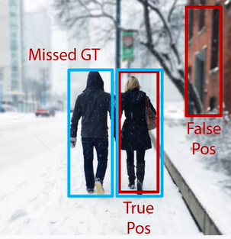
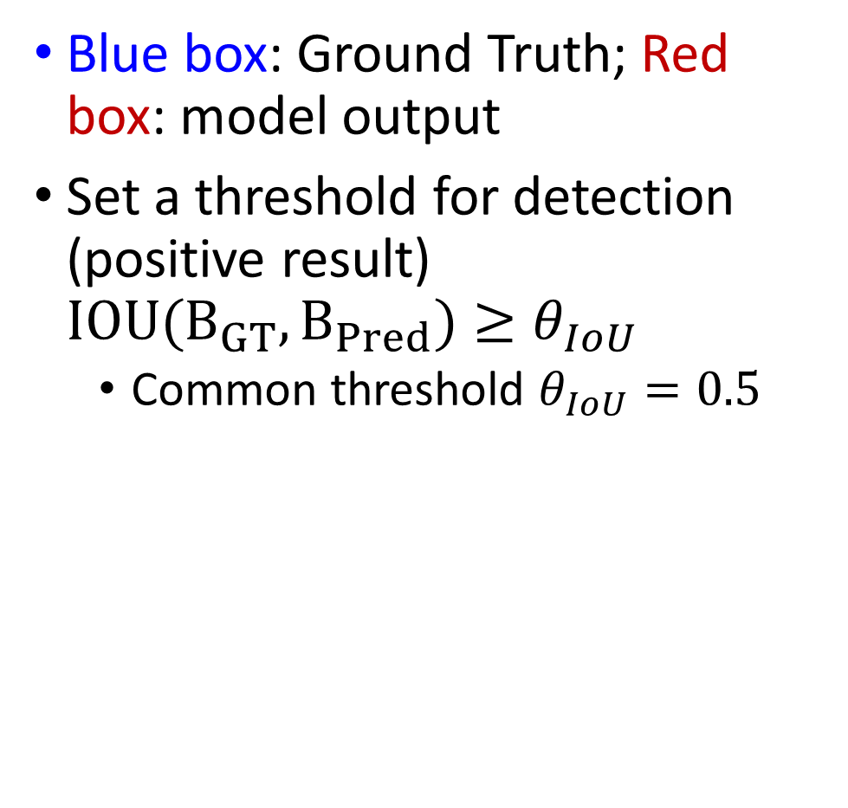
Detection Criteria (Intersection Over Union, IOU)
Blue box: Ground Truth; Red box: model output
Set a threshold for detection (positive result) $IOU(B_{GT},B_{Pred})≥θ_{IoU}$
Common threshold $θ_{IoU}=0.5$

Slide 8
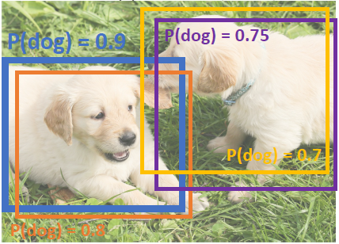
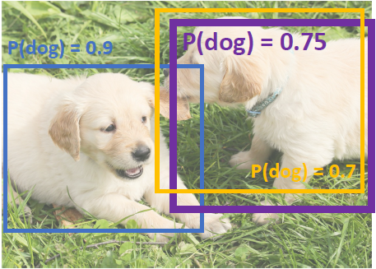
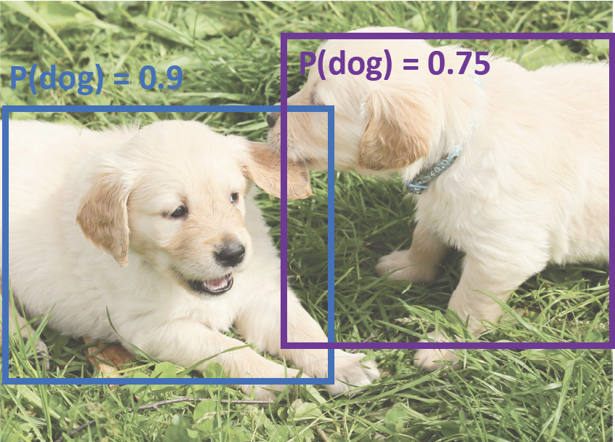
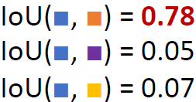

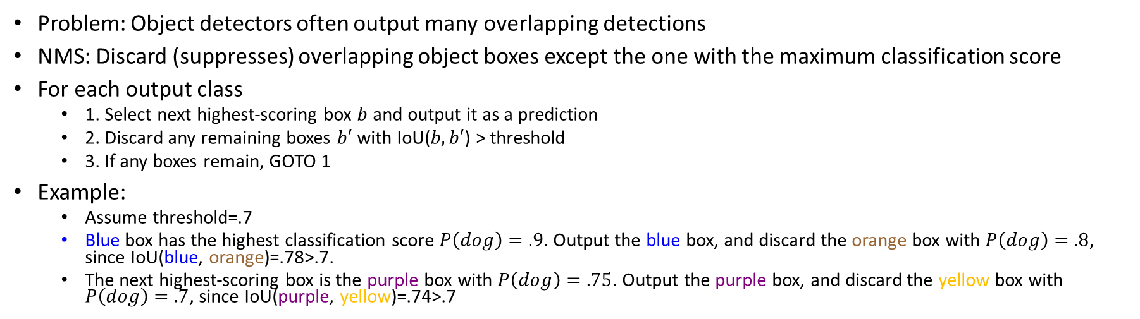
Non-Max Suppression (NMS)
Problem: Object detectors often output many overlapping detections
NMS: Discard (suppresses) overlapping object boxes except the one with the maximum classification score
For each output class
1. Select next highest-scoring box $b$ and output it as a prediction
2. Discard any remaining boxes $b′$ with IoU($b,b′$) > threshold
3. If any boxes remain, GOTO 1
Example:
Assume threshold=.7
Blue box has the highest classification score $P\left(dog\right)=.9$. Output the blue box, and discard the orange box with $P\left(dog\right)=.8$, since IoU(blue, orange)=.78>.7.
The next highest-scoring box is the purple box with $P\left(dog\right)=.75$. Output the purple box, and discard the yellow box with $P\left(dog\right)=.7$, since IoU(purple, yellow)=.74>.7

Slide 9
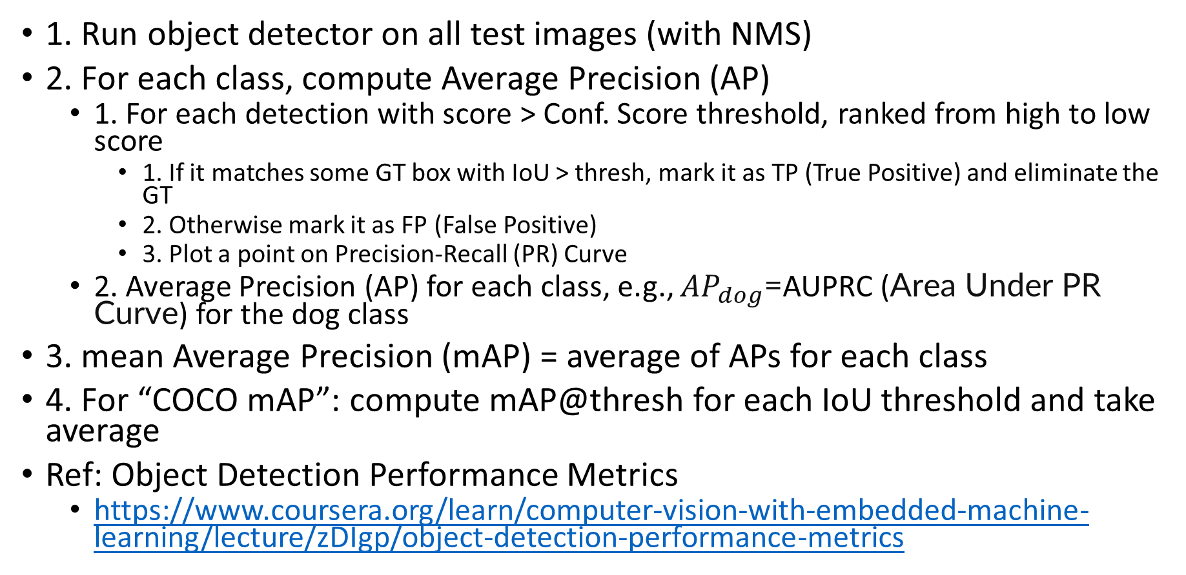
Evaluating Object Detectors: Mean Average Precision (mAP)
1. Run object detector on all test images (with NMS)
2. For each class, compute Average Precision (AP)
1. For each detection with score > Conf. Score threshold, ranked from high to low score
1. If it matches some GT box with IoU > thresh, mark it as TP (True Positive) and eliminate the GT
2. Otherwise mark it as FP (False Positive)
3. Plot a point on Precision-Recall (PR) Curve
2. Average Precision (AP) for each class, e.g., $AP_{dog}$=AUPRC (Area Under PR Curve) for the dog class
3. mean Average Precision (mAP) = average of APs for each class
4. For “COCO mAP”: compute mAP@thresh for each IoU threshold and take average
Ref: Object Detection Performance Metrics
https://www.coursera.org/learn/computer-vision-with-embedded-machine-learning/lecture/zDIgp/object-detection-performance-metrics

Slide 10
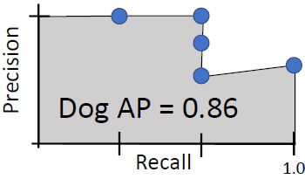
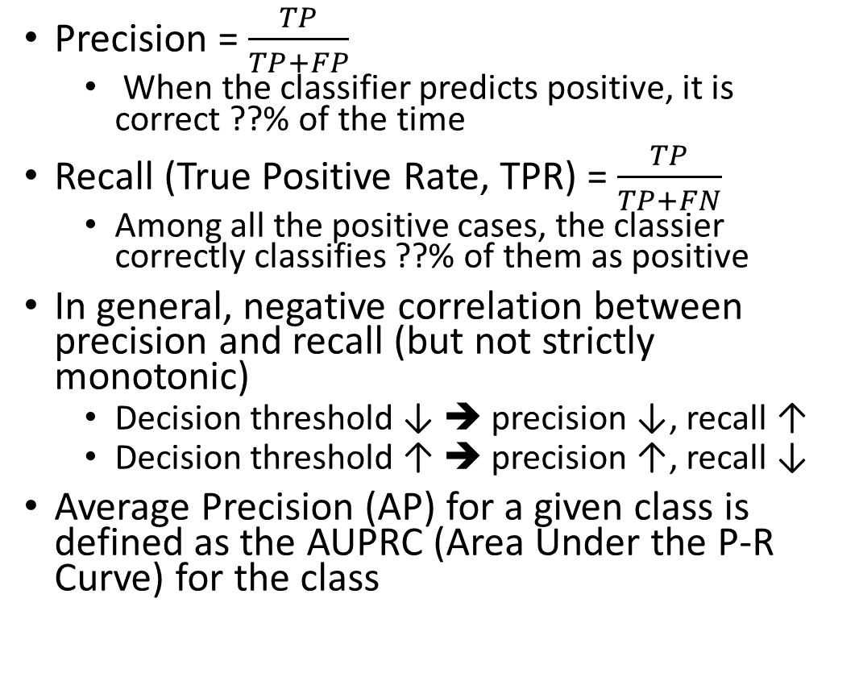
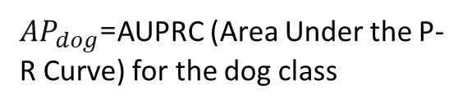
Precision, Recall, and Average Precision
Precision = $\frac{TP}{TP+FP}$
When the classifier predicts positive, it is correct ??% of the time
Recall (True Positive Rate, TPR) = $\frac{TP}{TP+FN}$
Among all the positive cases, the classier correctly classifies ??% of them as positive
In general, negative correlation between precision and recall (but not strictly monotonic)
Decision threshold ↓ ➔ precision ↓, recall ↑
Decision threshold ↑ ➔ precision ↑, recall ↓
Average Precision (AP) for a given class is defined as the AUPRC (Area Under the P-R Curve) for the class
Decision
thresh.
Distribution of negative data items
Distribution of positive data items
TN
TP
FN
FP
Feature
Predict negative
Predict positive
$AP_{dog}$=AUPRC (Area Under the P-R Curve) for the dog class

Slide 11
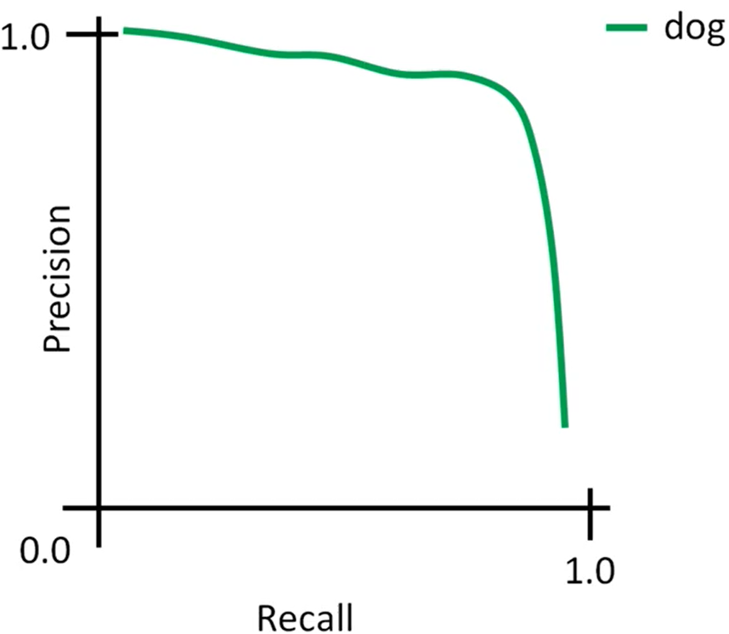
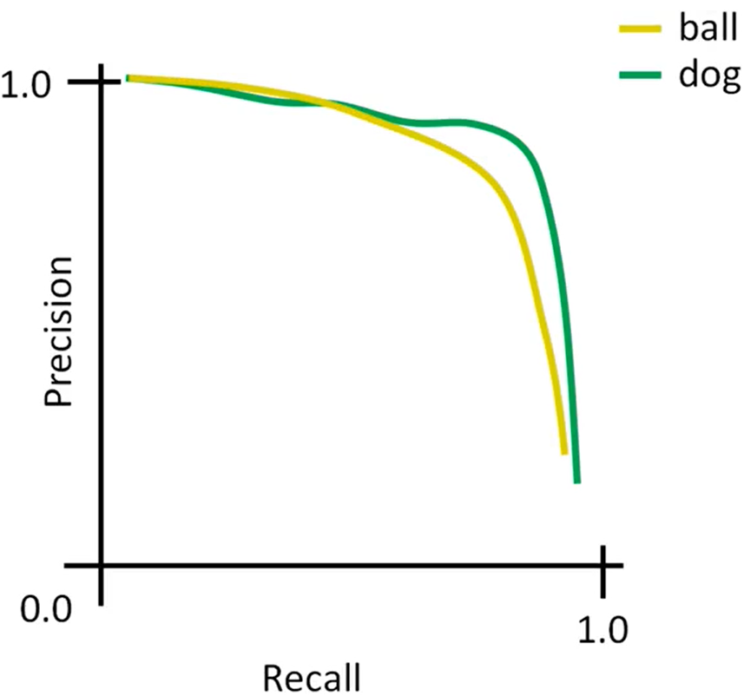
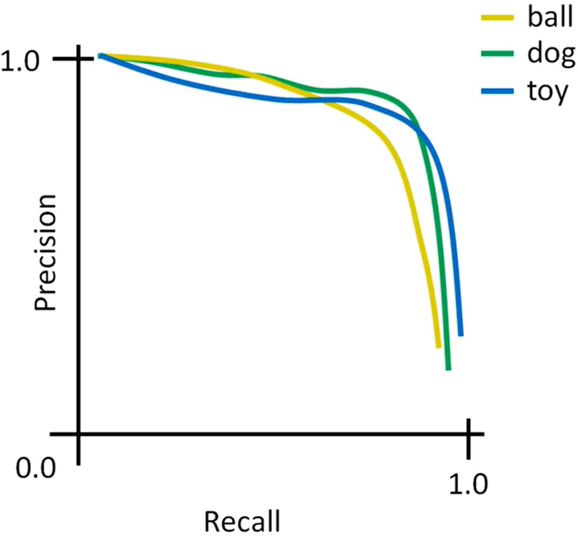

mean Average Precision (mAP)
AP for each class (either dog, or ball, or toy) w. IoU threshold 0.5 is AUPRC under each curve (either dog, or ball, or toy)
mAP for all 3 classes w. IoU threshold 0.5 is the average AP among 3 classes (dog, ball, toy)
$mAP_{0.5}=\frac{1}{3}(AP_{dog}+AP_{ball}+AP_{toy})$

Slide 12
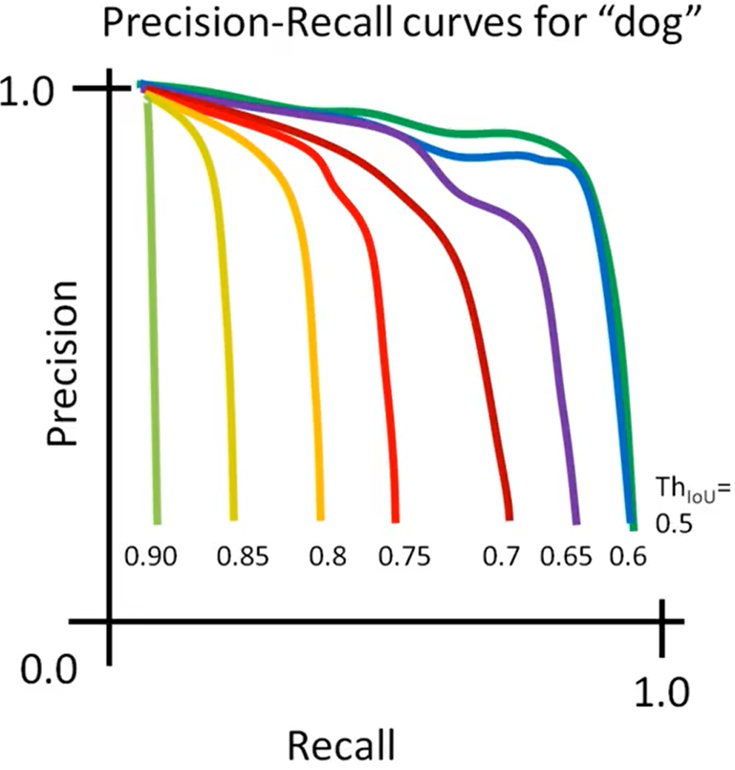
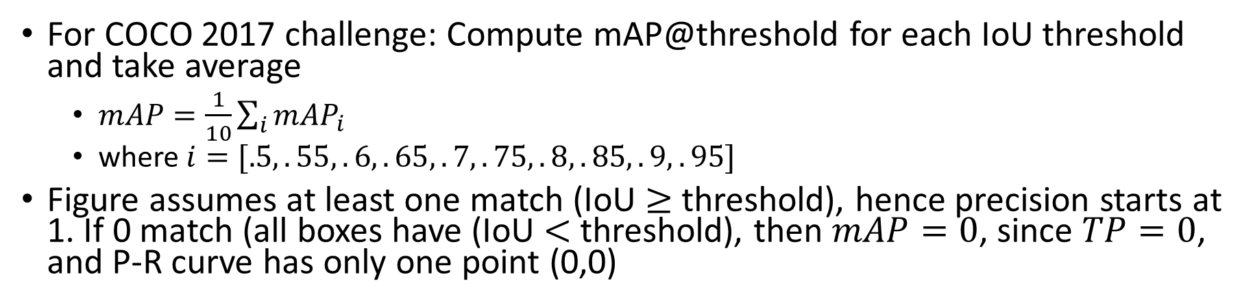
mAP
For COCO 2017 challenge: Compute mAP@threshold for each IoU threshold and take average
$mAP=\frac{1}{10}\sum_{i}{mAP_{i}}$
where $i=[.5,.55,.6,.65,.7,.75,.8,.85,.9,.95]$
Figure assumes at least one match (IoU $≥$ threshold), hence precision starts at 1. If 0 match (all boxes have (IoU $<$ threshold), then $mAP=0$, since $TP=0$, and P-R curve has only one point (0,0)

Slide 13
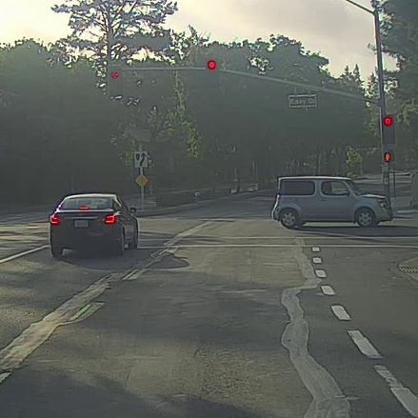
Detecting Multiple Objects: Sliding Window
Slide a box across the image, and apply a CNN to classify each image patch as object or background
https://www.coursera.org/learn/convolutional-neural-networks/lecture/VgyWR/object-detection

Slide 14
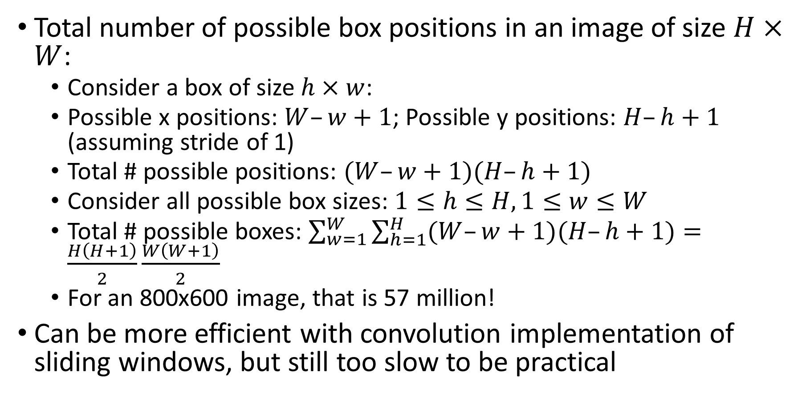
Sliding Window Computational Complexity
Total number of possible box positions in an image of size $H×W$:
Consider a box of size $h×w$:
Possible x positions: $W–w+1$; Possible y positions: $H–h+1$ (assuming stride of 1)
Total # possible positions: $(W–w+1)(H–h+1)$
Consider all possible box sizes: $1≤h≤H,1≤w≤W$
Total # possible boxes: $\sum_{w=1}^{W}{\sum_{h=1}^{H}{(W–w+1)(H–h+1)}}=\frac{H\left(H+1\right)}{2}\frac{W\left(W+1\right)}{2}$
For an 800x600 image, that is 57 million!
Can be more efficient with convolution implementation of sliding windows, but still too slow to be practical

Slide 15
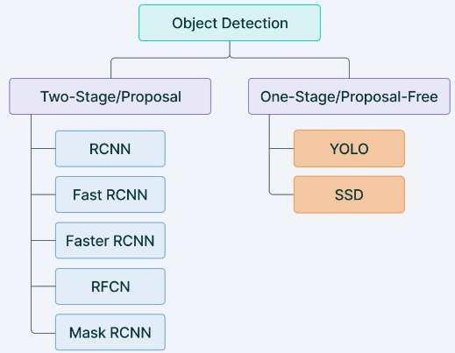
Two-stage vs. One-Stage Detector
Two-stage detector
1st step: generate Regions of Interests (Region Proposals) that are likely to contain objects
2nd step: perform object detection, incl. classification and regression of Bboxes of the objects
One-stage detector
Directly perform object detection, incl. classification and regression of Bboxes of the objects

Slide 16
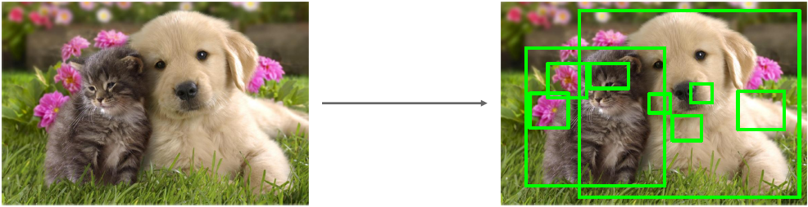
Region Proposals
Generating region proposals: find a small set of boxes that are likely to cover all objects, based on Selective Search, e.g., look for “blob-like” image regions
Relatively fast to run: e.g. can generate ~2000 region proposals in a few seconds on CPU

Slide 17
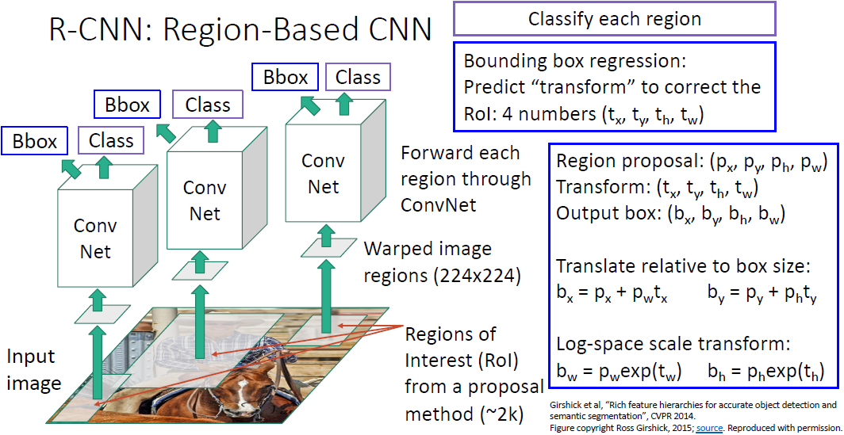
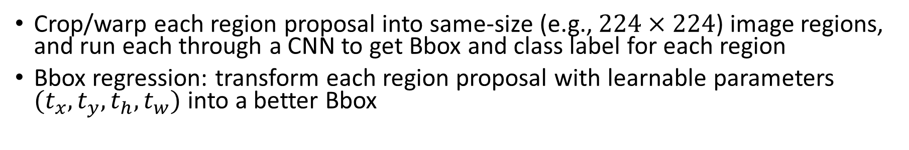
R-CNN: Training Time
Crop/warp each region proposal into same-size (e.g., $224×224$) image regions, and run each through a CNN to get Bbox and class label for each region
Bbox regression: transform each region proposal with learnable parameters $(t_{x},t_{y},t_{h},t_{w})$ into a better Bbox
17

Slide 18
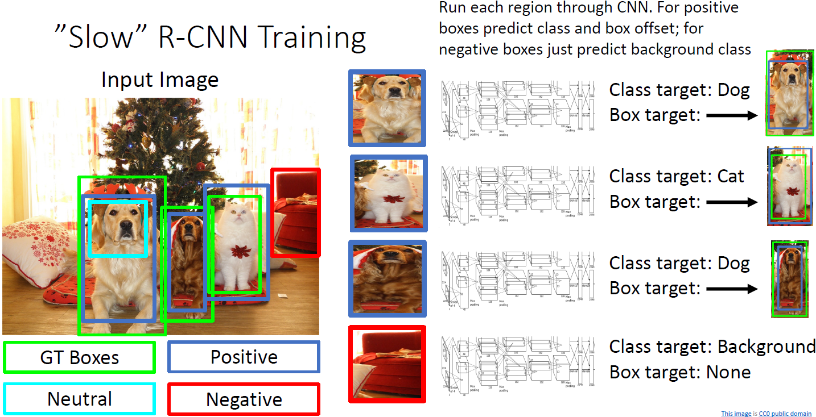
R-CNN Training Example
Categorize each region proposal as positive, negative, or neutral based on overlap with ground-truth boxes
Crop pixels from each positive and negative proposal, resize to 224 x 224
Use the CNN for Bbox regression and classification for positive boxes; only 1-class prediction for negative boxes

Slide 19
R-CNN: Test Time
1. Run region proposal method to compute ~2000 region proposals
2. Resize each region to 224x224 (tunable hyperparam) and run independently through the CNN to get feature vectors, then use Linear SVM to predict class scores, and Linear Regression to predict Bboxes
3. Use scores to select a subset of region proposals to output
Many choices here: threshold on background score (e.g., output bottom K proposals with lowest background scores), or per-class (e.g., output top K proposals with highest classification scores for the given class)…
4. Compare with ground-truth Bboxes
Inference time: ~40-50s per image
Extracting ~2000 regions for each image based on selective search
Extracting feature vectors using CNN for every image region.
Suppose we have N images, then the number of CNN features will be N*2000

Slide 20
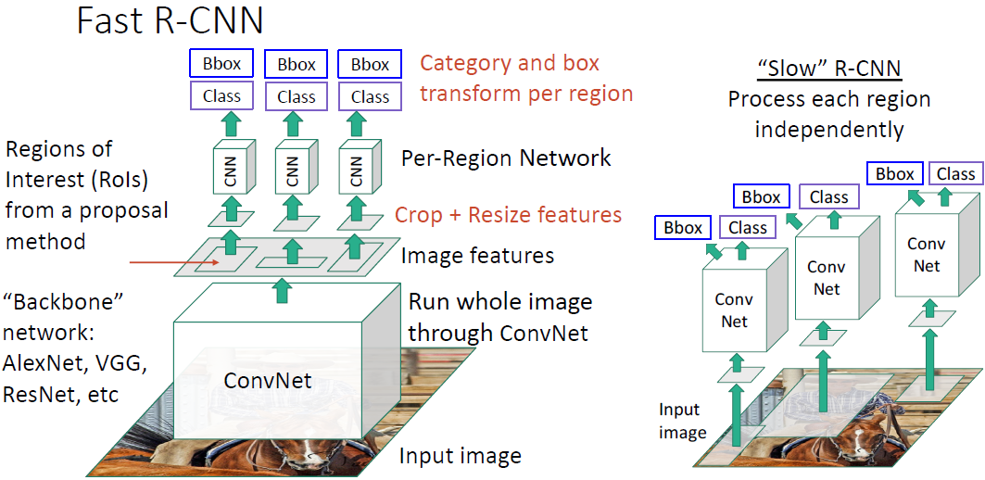
Fast R-CNN
1. Use a backbone network to extract feature maps from the whole image
2. Apply Selective Search on these feature maps and get object proposals
3. Use a lightweight Per-Region network to perform Bbox regression and classification
Most of the computation happens in backbone network; this saves work for overlapping region proposals compared to R-CNN

Slide 21
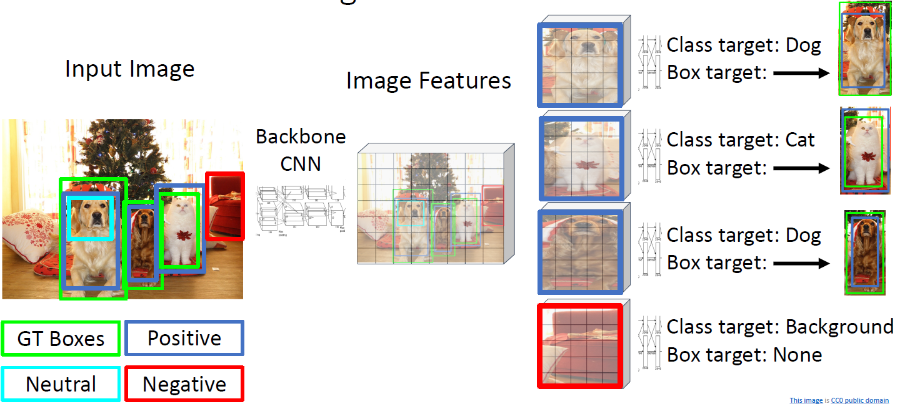
Fast R-CNN Training Example

Slide 22
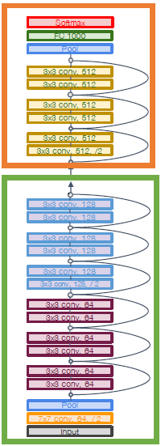
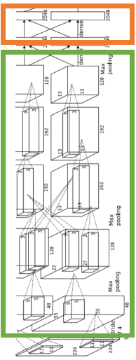
Example Backbone and Per-Region Networks
When using AlexNet for detection, 5 CONV layers are used for backbone and 2 FC layers are used for per-region network
For ResNet, the last stage (CONV+FC) is used as per-region network; the rest of the network is used as backbone
AlexNet
ResNet

Slide 23
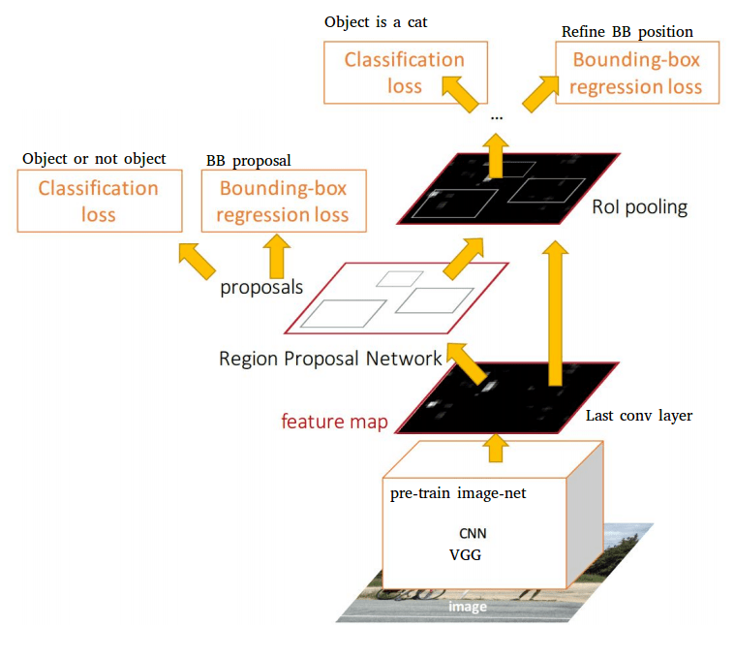
Faster R-CNN
Problem: Test time of Fast R-CNN is dominated by region proposals
Faster R-CNN: use Region Proposal Network (RPN) to generate region proposals from feature maps output by the backbone network
RPN is a learnable CNN that replaces Selective Search used by Fast R-CNN
Jointly train with 4 losses:
1. RPN classification: anchor box is object / not an object
2. RPN regression: predict transform from anchor box to Bbox proposal
3. Object classification: classify proposals as background / object class
4. Object regression: predict transform from proposal box to object Bbox
Notes:
Stage 1: Anchor -> Region Proposal -> Object Bbox

Slide 24
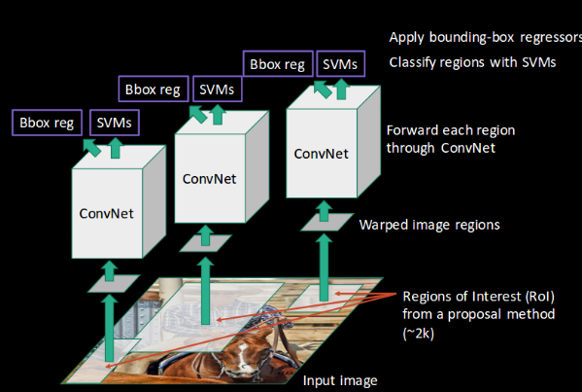
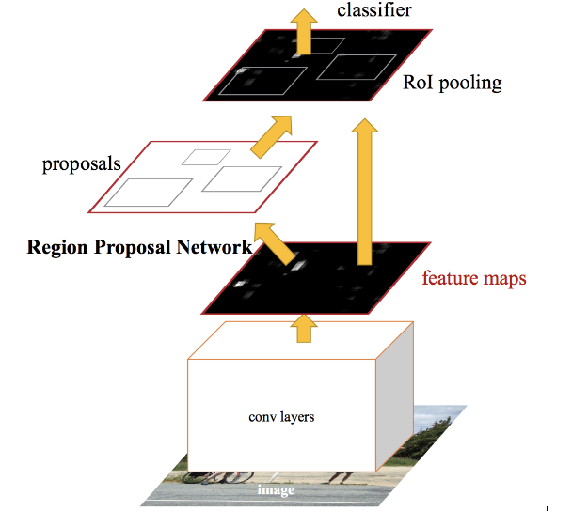
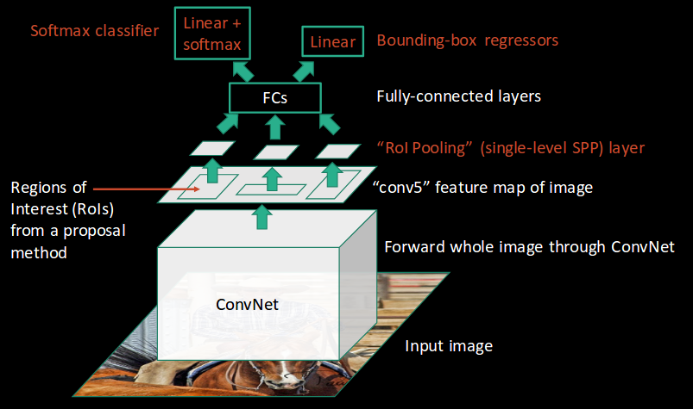
The R-CNN Family
R-CNN
Fast R-CNN
Faster R-CNN
Gerschick, “Fast R-CNN”, ICCV 2015

Slide 25
Summary of 3 Variants of R-CNN
Algorithm | Characteristics | Pred. Time/Img (s) | Limitations
R-CNN | Use Selective Search on the input image to generate regions. Extracts ~2000 regions from each image. | 40-50 | High computation time as each region is passed to the CNN separately
Fast R-CNN | Each image is passed only once to the CNN and feature maps are extracted. Use Selective Search on feature maps to generate predictions. Combines all the three models used in RCNN together. | 2 | Relatively high computation time using selective search
Faster R-CNN | Replaces Selective Search with Region Proposal Network to make the algorithm much faster. | 0.2

Slide 26
Two-stage vs. One-Stage Detector
Two-stage detector
1st step: generate Regions of Interests (Region Proposals) that are likely to contain objects
2nd step: perform object detection, incl. classification and regression of Bboxes of the objects
One-stage detector
Directly perform object detection, incl. classification and regression of Bboxes of the objects

Slide 27
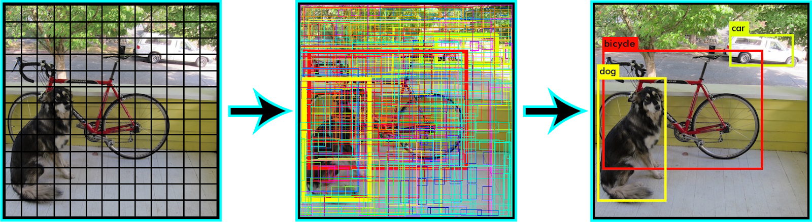
You Only Look Once (YOLO)
Divide the input image into n-by-n grids
For each grid, predict Bboxes and their class labels for objects (if any are found)
The Bboxes are highlighted by yellow color in the second step.
Apply Non-Maximal Suppression based on IoU, we suppress Bboxes with lower probability scores to achieve final Bboxes
Notes:
https://learnopencv.com/yolov7-object-detection-paper-explanation-and-inference/

Slide 28
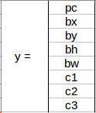
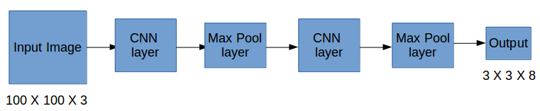
Label for a Grid cell
Suppose we divide the image into a 3x3 grid. We define 3 classes (Pedestrian, Car, Motorcycle)
For each grid cell, the label y is an 8-D vector
p_{c} defines whether an object is present in the grid or not (it is the probability)
(b_{x}, b_{y}, b_{h}, b_{w}) specify the Bbox if there is an object
(c₁, c₂, c₃) represent one-hot vector as the target label (or the class confidence scores computed by SoftMax during inference)
For each of the 3x3 grid cells, we have an 8-D output vector. So the output dimension is 3x3x8
Even if an object may span more than one grid, it will only be assigned to a single grid cell in which its mid-point is located

Slide 29
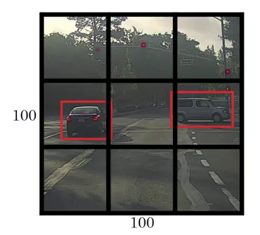
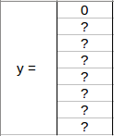
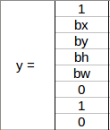
Two Grid Cells
Since there is no object in this grid, pc=0, and all the other entries are “don’t care”, denoted as “?”
Since there is an object (Car) in this grid, pc=1. (bx, by, bh, bw) are calculated relative to the particular grid cell
Class label is (0,1,0) since Car is the 2nd class

Slide 30
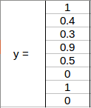
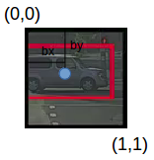
An Example Grid Cell
(b_{x}, b_{y})=(0.4, 0.3): coordinates of the midpoint of the object with respect to this grid
(b_{h}, b_{w})=(0.5, 0.9):
b_{h} = 0.5 is ratio of the height of the Bbox (red box) to the height of the grid cell
b_{w} = 0.9 is ratio of the width of the Bbox to the width of the grid cell
b_{x} and b_{y} will never exceed 1, as the midpoint will always lie within the grid. Whereas b_{h} and b_{w} can exceed 1 if the dimensions of the Bbox are more than the dimension of the grid
Class label is (0,1,0) for the Car class
=
0.5
0.9
0.5

Slide 31
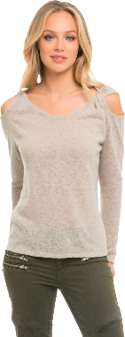


Anchor Boxes
Place $K$ anchor boxes centered at each position in the feature map, each with different sizes and aspect ratios ($K=2$ in the fig)
This allows detection of multiple objects centered at the same position, with better-fitting anchor boxes, which helps ease the downstream Bbox regression task
Ref: “Finally understand Anchor Boxes in Object Detection (2D and 3D)”
https://www.thinkautonomous.ai/blog/anchor-boxes
Notes:
One of the main improvements in YOLO v2 is the use of anchor boxes. Anchor boxes are a set of predefined bounding boxes of different aspect ratios and scales. When predicting bounding boxes, YOLO v2 uses a combination of the anchor boxes and the predicted offsets to determine the final bounding box. This allows the algorithm to handle a wider range of object sizes and aspect ratios.
https://www.thinkautonomous.ai/blog/anchor-boxes/
https://towardsdatascience.com/training-yolo-select-anchor-boxes-like-this-3226cb8d7f0b

Slide 32




Anchor Boxes
Suppose we have 2 anchor boxes for each grid cell. Then we can detect at most two objects for each grid cell
First 8 rows of the y label belong to anchor box 1 and the remaining 8 belong to anchor box 2. The y vector has 16 entries, and the output has dimension 3x3x2x(5+3) =3x3x16 (for each of the 3x3 grid cells, there is a $y$ vector with size 2x8=16)
The objects are assigned to the anchor boxes based on the similarity of the Bboxes and the anchor box shape, e.g., the person is assigned to anchor box 1 and the car is assigned to anchor box 2
Suppose we use 3x3 grid, 2 anchor boxes per grid and the number of classes is 4, then the output has dimension 3x3x2x(5+4)= 3x3x18 (for each of the 3x3 grid cells, there is a $y$ vector with size 2x9=18)
Suppose we use 4x4 grid, 5 anchor boxes per grid and the number of classes is 5, then the output has dimension 4x4x5x(5+5)=4x4x50 (for each of the 4x4 grid cells, there is a $y$ vector with size 5x10=50)

Slide 33
Realistic YOLO Dimensions
Input image has shape (608, 608, 3)
The CNN output has dimension (19, 19, 5, 85), where each grid cell returns 5*85 numbers, with total dimension of 19*19*5*85
5 is the number of anchor boxes per grid
85 = 5+80, where 5 refers to (pc, bx, by, bh, bw), and 80 is the number of classes
Finally, compute IoU and perform NMS

Slide 34

YOLO with FPN
Backbone extracts essential features of an image and feeds them to the Head through Neck
Neck is a Feature Pyramid Network (FPN) that collects feature maps extracted by the Backbone and creates feature pyramids
An FPN is a feature extractor that takes a single-scale image of an arbitrary size as input, and outputs proportionally sized feature maps at multiple levels
Head consists of output layers that make final detections
Dense prediction (one-stage), sparse prediction (two-stage)
Notes:
https://jonathan-hui.medium.com/understanding-feature-pyramid-networks-for-object-detection-fpn-45b227b9106c
https://medium.com/@mohamedelhacen/deep-learning-based-object-detection-methods-part-2-f5554810e2c#:~:text=The%20role%20of%20the%20head,the%20prediction%2C%20and%20the%20label.

Slide 35

Performance Comparisons
Two stage method (Faster R-CNN) get the best accuracy, but are slower
Single-stage methods (SSD) are much faster, but don’t perform as well
Bigger backbones improve performance, but are slower

Slide 36

Outline
Object detection
Segmentation

Slide 37



Types of Segmentation Tasks
Things vs. stuff
Things: Object categories that can be separated into object instances (e.g. cats, cars, person)
Stuff: Object categories that cannot be separated into instances (e.g. sky, grass, water, trees)
Object Detection vs. Semantic Segmentation vs. Instance Segmentation
Object Detection: Detects object instances, but only gives Bbox (things only)
Semantic Segmentation: Label all pixels, but merges instances (both things and stuff)
Instance Segmentation: Detect all object instances and label the pixels that belong to each object (things only)
Approach: Perform object detection, then predict a segmentation mask for each object
Panoptic Segmentation: In addition to Instance Segmentation, also label the pixels that belong to each thing
Semantic Segmentation
Instance Segmentation
Panoptic Segmentation

Slide 38

Semantic Segmentation: Task Definition
Label each pixel in the image with a class label
Don’t differentiate among multiple instances (e.g., pixels of the 2 cows are given the same label)

Slide 39


Ground Truth Per-Pixel Labels

Slide 40

Ground Truth Per-Pixel Labels
One output channel for each of the 5 possible classes.
Pixel-wise Cross-Entropy Loss

Slide 41



Fully Convolutional Network (FCN)
A CNN with all CONV layers (no FC layers) for making predictions for all pixels all at once. Loss function is per-pixel Cross-Entropy loss
Problem #1: Convolution on high-res images without downsampling is expensive
Problem #2: Effective receptive field size grows slowly in the feedforward direction with number of CONV layers: with L 3x3 CONV layers, receptive field grows as 2L+1 (3x3, 5x5, 7x7…)
2 stacked $3×3$ CONV layers w. padding $P=1$ have the same effective receptive field as a $5×5$ CONV layer

Slide 42

More Efficient FCN
A CNN with CONV layers that perform downsampling followed by upsampling
Downsampling with pooling or strided convolution to reduce feature map size. It allows effective receptive field size to grow quickly in the feedforward direction, and also leads to more efficient computation
Upsampling with interpolation or transposed convolution to increase feature map size.
Methods: Bed Of Nails, Nearest Neighbor, Max-Unpooling, Bilinear/Bicubic Interpolation, Transposed Convolution
Downsampling followed by upsampling produces the same-size output as the original input

Slide 43

Bed Of Nails, Nearest Neighbor
Upsampling from a 2x2 image to a 4x4 image, by either inserting 0s (Bed of Nails), or duplicating elements (Nearest Neighbor)

Slide 44

Max Unpooling

Slide 45


Bilinear/Bicubic Interpolation
Upsampling from a 2x2 image to a 4x4 image with bilinear or bicubic interpolation
Each output element is computed as a linear or cubic combination of its closest neighbors to generate smooth outputs
Bilinear interpolation
Bicubic interpolation
Notes:
https://www.cs.toronto.edu/~guerzhoy/320/lec/upsampling.pdf
https://github.com/YasinEnigma/Image_Interpolation
https://datascience.stackexchange.com/questions/38118/what-is-the-difference-between-upsampling-and-bi-linear-upsampling-in-a-cnn
Bilinear interpolation: use 4 closest neighbors in x and y to construct linear approximations
Bicubic interpolation: use 3 closest neighbors in x and y to construct cubic approximations

Slide 46


Transposed Convolution
To upsample a 2x2 input feature map to a 3x3 output feature map by transposed convolution, we apply a kernel of size 2x2 with unit stride and zero padding
Right figure: take the upper left element of the input feature map and multiply it with every element of the kernel
Bottom figure: do it for all the remaining elements of the input feature map, and add the output elements of the over-lapping positions to get output feature map
May need to trim top row and left column to get desired output feature map size
It has many names: Transposed Convolution, Deconvolution, Upconvolution, Fractionally-strided convolution
https://towardsdatascience.com/transposed-convolution-demystified-84ca81b4baba
Notes:
The filter moves at a slower pace than with unit stride

Slide 47

Mask R-CNN for Instance Segmentation
Add an extra “Mask Prediction” head on top of Faster R-CNN for Object Detection
Notes:
Mask Region based Convolution Neural Networks - EXPLAINED!
https://www.youtube.com/watch?v=4tkgOzQ9yyo

Slide 48

Mask R-CNN for Instance Segmentation

Slide 49

Example Target Segmentation Masks
Target segmentation mask
for class “chair” in the Bbox
Target segmentation mask
for class “person” in the Bbox

